Slide 1
Advance Web Application Development

Slide 2
What is Website
A website is a collection of web pages and related content that is identified by a common domain name and published on at least one web server. (https://en.wikipedia.org/wiki/Website)
Different companies, Govt or private organization etc create their web to provide their information through internet. More over clients can also communication with them using their website.
Website is accessed through web browser.

Slide 3
What is Web Development
Web development is the process of building and maintaining a website for the Internet or an intranet that is accessed through a web browser and hosted on a server, either on on-premises hardware or in the cloud. This includes everything from single plain-text webpages up to complex web applications.
(https://www.webopedia.com/definitions/web-development/)

Slide 4
Successful storeis
Facebook by Mark Zuckerberg: https://www.investopedia.com/articles/personal-finance/081315/mark-zuckerberg-success-story-net-worth-education-top-quotes.asp
get users’ info and can provide trends e.g. favourit colors of females in specific area and other info)
Google.com
(search engin website, have not any ad on page, but use two way mechanasim to earn. website owner (adsense), clients for ads (adword))

Slide 5
Successful Stories
Yourtube.com : online ads on videos
Yahoo.com
Alibaba.com
The Inspiring Life Story Of Alibaba Founder Jack Ma, Now The Richest Man In China
https://www.shoutmeloud.com/jack-ma-alibaba-founder.html#:~:text=Jack%20Ma%20is%20the%20founder,IPO%20filing%20of%20his%20company.
https://www.businessinsider.com/the-inspiring-life-story-of-alibaba-founder-jack-ma-2014-10

Slide 6
Successful Stories
Yourtube.com : online ads on videos
Yahoo.com
Microsoft founders:
In 1975 Bill Gates and Paul G. Allen, two boyhood friends from Seattle, converted BASIC, a popular mainframe computer programming language, for use on an early personal computer (PC), the Altair. Shortly afterward, Gates and Allen founded Microsoft, deriving the name from the words microcomputer and software.

Slide 7
Job opportunities after this course
Freelancing websites including:
Fiverr
Freelancing
Upwork
Govt Institutes
Software Houses
All private institutes who managing own and other websites

Slide 8
Courses Objectives
Introduction to Web Development
Installation of Tools (Development and Running website)
HTML
CSS
PHP
Graphic Tools
Web Designing
Java Scripting
J Query
MySQL
AJAX
Laravel

Slide 9
Ethical Web Development
Web applications should work for everyone
eb applications should work everywhere
Web applications should respect a user's privacy and security
Don’t use copied multimedia, text and other contents including Images, videos etc on your with out permission of owner of that contents and as acknowledge by display information of source of you use it on your website
(https://www.ethicalweb.org/)

Slide 10
Cyber Crimes
Cybercrime is criminal activity that either targets or uses a computer, a computer network or a networked device. https://www.kaspersky.com/resource-center/threats/what-is-cybercrime
Hacking
Financial Frauds
Digital Privacy (using other contents etc.)
DATA THEFT
IDENTITY THEFT
Database Attachs (SQL injecte etc)
http://www.fia.gov.pk/en/NR3C.php

Slide 11
Cyber Crimes
Phishing
A phishing campaign is when spam emails, or other forms of communication, are sent massage, with the intention of tricking recipients into doing something that undermines their security or the security of the organization they work for.
Phishing campaign messages may contain infected attachments or links to malicious sites. Or they may ask the receiver to respond with confidential information
http://www.fia.gov.pk/en/NR3C.php

Slide 12
World Wide Web (WWW)
World Wide Web, which is also known as a Web, is a collection of websites or web pages stored in web servers and connected to local computers through the internet.
These websites contain text pages, digital images, audios, videos, etc.
Users can access the content of these sites from any part of the world over the internet using their devices such as computers, laptops, cell phones, etc.
The WWW, along with internet, enables the retrieval and display of text and media to your device. https://www.javatpoint.com/what-is-world-wide-web

Slide 13
World Wide Web (WWW)
The building blocks of the Web are web pages which are formatted in HTML and connected by links called "hypertext" or hyperlinks and accessed by HTTP.
These links are electronic connections that link related pieces of information so that users can access the desired information quickly.
A web page is given an online address called a Uniform Resource Locator (URL).
A particular collection of web pages that belong to a specific URL is called a website. E.g. www.facebook.com, www.google.com

Slide 14
World Wide Web (WWW)
So, the World Wide Web (WWW) is like a huge electronic book whose pages are stored on multiple servers across the world.
Normally, Small websites store all of their WebPages on a single server, but big websites or organizations place their WebPages on different servers in different countries so that when users of a country search their site they could get the information quickly from the nearest server.

Slide 15
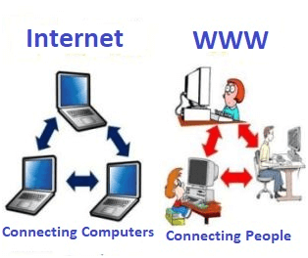
Difference between World Wide Web and Internet
Some people use the terms 'internet' and 'World Wide Web' interchangeably.
But World Wide Web and Internet are not same terms
Internet is entirely different from WWW
https://www.javatpoint.com/what-is-world-wide-web

Slide 16
Difference between World Wide Web and Internet
Internet:
worldwide network of devices like computers, laptops, tablets, etc
It enables users to send emails to other users and chat with them online. For example, when you send an email or chatting with someone online, you are using the internet.
https://www.javatpoint.com/what-is-world-wide-web

Slide 17
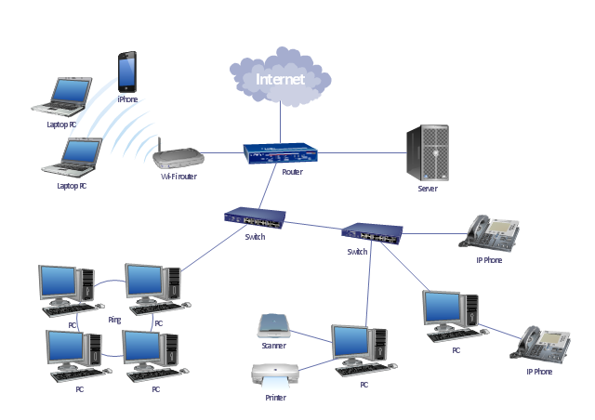
Internet
Twisted Pair Cable
Connectors E.g. RJ45
Fiber Cable e.g. submarine
Wifi Access Point
Nework Switches
Network Routers
Server computers
Clients Computers
Mobile Devices etc
https://www.conceptdraw.com/examples/router-switch-server-diagram

Slide 18
Difference between World Wide Web and Internet
World Wide Web:
when you have opened a website like google.com for information, you are using the World Wide Web; a network of servers over the internet
You request a webpage from your computer using a browser, and the server renders that page to your browser. Your computer is called a client who runs a program (web browser), and asks the other computer (server) for the information it needs. Which is called web hosted server.
https://www.javatpoint.com/what-is-world-wide-web

Slide 19
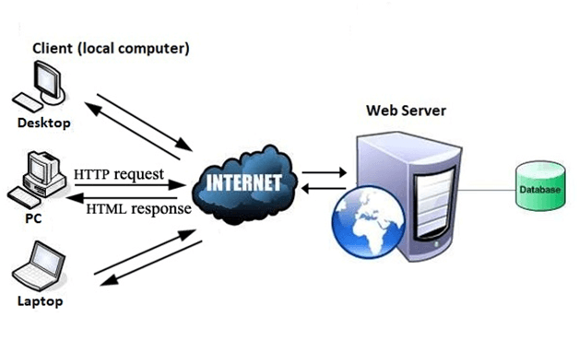
World Wide Web (WWW)
Website hosing server
Client use Browser on Computer, Mobile devices to open website
Internet for communication of website
https://www.javatpoint.com/what-is-world-wide-web

Slide 20
World Wide Web
Inernet

Slide 21
World Wide Web
The World Wide Web (WWW), commonly known as The Web, is an information system where documents and other web resources are identified by Uniform Resource Locators (URLs, such as https://example.com/), which may be interlinked by hyperlinks, and are accessible over the Internet.
The resources of the Web are transferred via the Hypertext Transfer Protocol (HTTP), may be accessed by users by a software application called a web browser, and are published by a software application called a web server.

Slide 22
World Wide Web
English scientist Sir Timothy Berners-Lee invented the World Wide Web in 1989.
He wrote the first web browser in 1990 while employed at European Organization for Nuclear Research (CERN) near Geneva, Switzerland.
] The browser was released outside CERN to other research institutions starting in January 1991.
The general public in August 1991. The Web began to enter everyday use in 1993-4.
Wikepedia.org
https://home.cern/science/computing/birth-web/short-history-web

Slide 23
Generation/Version of World Wide Web
Generation/ Version of Web are divided by its functionality.
Web 1.0 Statics Website
Web 2.0 Dynamic Web Pages and User Interaction
Web 3.0 Smart Applications, Live streaming, Smart user interaction etc
Details on next slides
https://www.geeksforgeeks.org/web-1-0-web-2-0-and-web-3-0-with-their-difference/

Slide 24
Web 1.0
first stage of the World Wide Web evolution. Introduced in 1989.
Earlier, there were only few content creators in Web 1.0 with the huge majority of users who are consumers of content.
Personal web pages were common, consisting mainly of static pages hosted on ISP-run web servers
In Web 1.0 advertisements on websites while surfing the internet is banned
Web 1.0 is a content delivery network (CDN) which enables to showcase the piece of information on the websites.

Slide 25
Web 1.0
Four design essentials of a Web 1.0 site include:
Static pages.
Content is served from the server’s file-system.
Pages built using Server Side Includes or Common Gateway Interface (CGI).
Frames and Tables used to position and align the elements on a page.

Slide 26
Web 2.0
Web 2.0 is the second generation of web. It was defined by Dale Dougherty in 2004 as a read-write web. (Choudhury, 2014)
Web 2.0 is enhanced version of Web 1.0.
Refers to world wide website which highlight user-generated content, usability and interoperability for end users
Web 2.0 is also called participative social web.
It does not refer to a modification to any technical specification
but to modify in the way Web pages are designed and used.
An interaction and collaboration with each other is allowed by Web 2.0 in a social media dialogue as creator of user-generated content in a virtual community.
The web browser technologies are used in Web 2.0 development and it includes AJAX and JavaScript frameworks.

Slide 27
Web 2.0
Recently, AJAX and JavaScript frameworks have become a very popular means of creating web 2.0 sites.
Five major features of Web 2.0 –
Free sorting of information, permits users to retrieve and classify the information collectively.
Dynamic content that is responsive to user input.
Information flows between site owner and site users by means of evaluation & online commenting.
Developed APIs to allow self-usage, such as by a software application.
Web access leads to concern different, from the traditional Internet user base to a wider variety of users.

Slide 28
Web 2.0
Usage of Web 2.0
The social Web contains a number of online tools and platforms where people share their perspectives, opinions, thoughts and experiences. Web 2.0 applications tend to interact much more with the end user.
Podcasting
Blogging
Tagging
Curating with RSS
Social bookmarking
Social networking
Social media
Web content voting
Helpful link: https://en.wikipedia.org/wiki/Web_2.0

Slide 29
Web 3.0
y John Markoff of the New York Times and he suggested web 3.0 as third generation of the web in 2006. Web 3.0 can be also stated as “executable Web”
It refers the evolution of web utilization and interaction which includes altering the Web into a database. In enables the upgradation of back-end of the web, after a long time of focus on the front-end
Web 3.0 is a term which is used to describe many evolutions of web usage and interaction among several paths.
The Semantic Web s an extension of the World Wide Web through standards set by the World Wide Web Consortium (W3C). The goal of the Semantic Web is to make Internet data machine-readable.
https://en.wikipedia.org/wiki/Semantic_Web#Web_3.0

Slide 30
Difference between Web 1.0, Web 2.0 and Web 3.0
https://en.wikipedia.org/wiki/Semantic_Web#Web_3.0

Slide 31
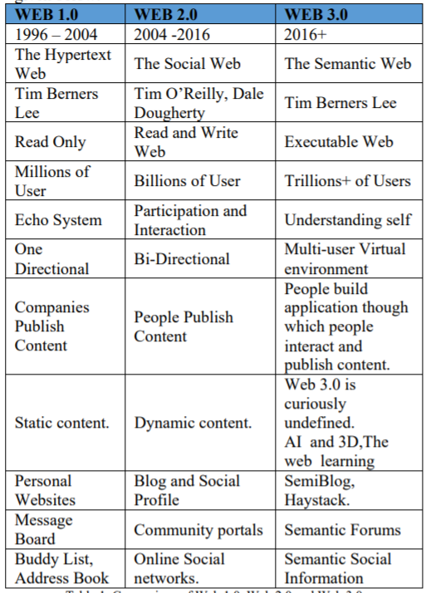
Chaudry, 2014

Slide 32
WEB 4.0 AND FUTURE WEB
Web 4.0 can be considered as an Ultra-Intelligent Electronic Agent, symbiotic web and Ubiquitous web.
Interaction between humans and machines in symbiosis was motive behind of the symbiotic web.
Powerful as human brain, progress in the development of telecommunications, advancement on nanotechnology in the world and controlled interfaces using web 4.0.
Insimple words, machines would be clever on reading the contents of the web, and react in the form of executing and deciding what to execute first to load the websites fast with superior quality and performance and build more commanding interfaces

Slide 33
Static Website VS Dynamic Website
Websites are separated into two different types:
Static
dynamic.
Static websites are ones that are fixed and display the same content for every user, usually written exclusively in HTML. static websites are easier to create.
A dynamic website, on the other hand, is one that can display different content and provide user interaction, by making use of advanced programming and databases in addition to HTML. ynamic websites require more work.
https://wpamelia.com/static-vs-dynamic-website/

Slide 34
Static Website
You don't need the knowledge of web programming and database design to create a static website. Its web pages are coded in HTML.
The codes are fixed for each page so the information contained in the page does not change and it looks like a printed page.
you can use various multimedia elements and videos. An HTML website can look beautiful, but the page’s source code won’t change, no matter what actions a user takes on it.

Slide 35
Static Website VS Dynamic Website
a dynamic website is more functional. It allows users to interact with the information that is listed on the page. Of course, that requires utilizing more than just HTML code.
Static websites use only client-side HTML and CSS code while dynamic websites rely on both client-side and server-side scripting languages such as JavaScr
When a user accesses a dynamic website, the site can be changed through code that is run in the browser and/or on the server. The end result is the same as that on a static website: an HTML page displayed on the web browser.ipt, PHP, or ASP.
To generate dynamic content, such websites use a combination of server-side and client-side scripting. Client-side scripting refers to code that is executed by the browser, usually with JavaScript. Meanwhile, server-side scripting refers to code that is executed by the server (before the content is sent to the user’s browser).
dynamic websites include aspects that are characterized by interactivity and functionality.

Slide 36
Static Website VS Dynamic Website
The only way that a user can interact with a static page is by clicking hyperlinks and filling in forms (such as a contact form).
Dynamic websites are ultimately based on HTML and CSS as well, but server-side scripting is required to make them functional.
HTML coding is used to create the basic design elements, while server-side languages are used to manage events and control actions that may occur on the dynamic page.
https://wpamelia.com/static-vs-dynamic-website/

Slide 37
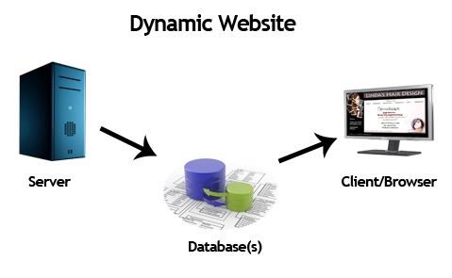
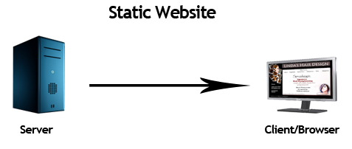

Slide 38
Static VS Dynamic Websites
Static Website | Dynamic Website
Prebuilt content is same every time the page is loaded. | Content is generated quickly and changes regularly.
It uses the HTML code for developing a website. | It uses the server side languages such as PHP,SERVLET, JSP, and ASP.NET etc. for developing a website.
It sends exactly the same response for every request. | It may generate different HTML for each of the request.
The content is only changed when someone publishes and updates the file (sends it to the web server). | The page contains "server-side" code which allows the server to generate the unique content when the page is loaded.
Flexibility is the main advantage of static website. | Content Management System (CMS) is the main advantage of dynamic website.

Slide 39
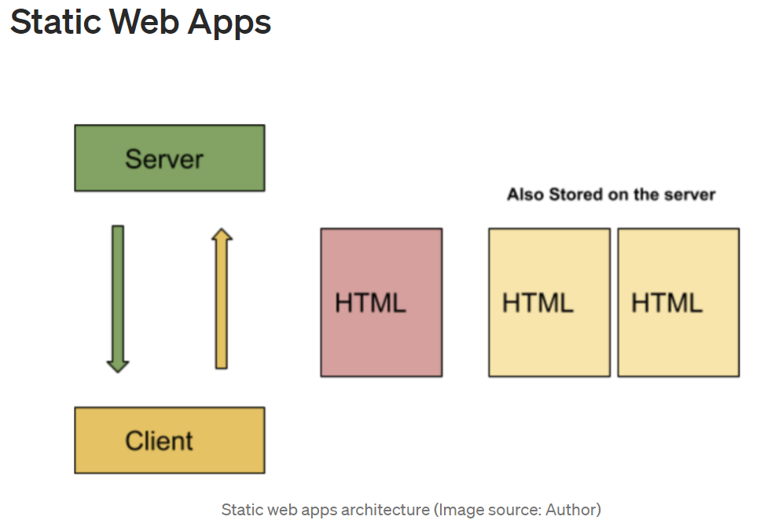
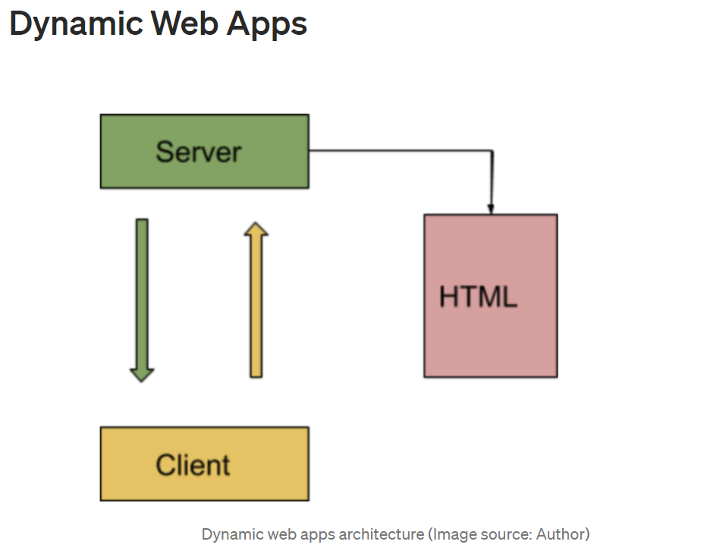
Architecture of Static & Dynamic Website
For detail visit:
https://betterprogramming.pub/web-development-in-2021-dynamic-vs-static-vs-single-page-architecture-399d0c3defe6

Slide 40
Referencing
Chaudry N., 2014," World Wide Web and Its Journey from Web 1.0 to Web 4.0., International Journal of Computer Science and Information Technologies, Vol. 5 (6) , 2014, 8096-8100
En.wikipwdia.org (13-06-2021)
www.geeksforgeeks.org (13-06-2021)
www.javatpoint.com (13-06-2021)

